Slide 1

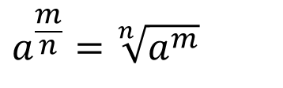



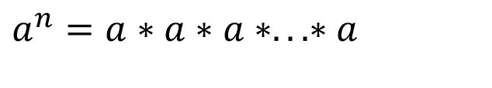






n раз
$$a^{0}=1$$
$$a^{n}=a∗a∗a∗.. . ∗a$$
$$a^{1}=a$$
$$a^{−n}=\frac{1}{a^{n}}$$
$$a^{n}=a∗a∗a∗.. . ∗a$$
$$a^{n}∗a^{m}=a^{n+m}$$
$$a^{n}:a^{m}=a^{n−m}$$
$$a^{n}$$
$${(a^{n})}^{m}=a^{nm}$$
$${(a:b)}^{n}=a^{n}:b^{n}$$
$${(a∗b)}^{n}=a^{n}∗b^{n}$$
$$a^{\frac{m}{n}}=\sqrt[n]{a^{m}}$$

Slide 2








$$z_{1}+z_{2}=\left(a_{1}+b_{1}i\right)+\left(a_{2}+b_{2}i\right)= (a_{1}+a_{2}) +\left(b_{1}+b_{2}\right)i$$
$$z_{1}−z_{2}=\left(a_{1}+b_{1}i\right)−\left(a_{2}+b_{2}i\right)= (a_{1}−a_{2}) +\left(b_{1}−b_{2}\right)i$$
$A⊂В$
$$A=\{a, b, c, d, e\}$$
$$z_{1}∗z_{2}=\left(a_{1}+b_{1}i\right)∗\left(a_{2}+b_{2}i\right)=a_{1}a_{2}+a_{1}b_{2}i+b_{1}a_{2}i+b_{1}b_{2}i^{2}=\left(a_{1}a_{2}+b_{1}b_{2}i^{2}\right)+\left(a_{1}b_{2}i+b_{1}a_{2}i\right)=\left(a_{1}a_{2}−b_{1}b_{2}\right)+\left(a_{1}b_{2}i+b_{1}a_{2}i\right)$$
$$\frac{z_{1}}{z_{2}}=\frac{a_{1}+b_{1}i}{a_{2}+b_{2}i}=\frac{\left(a_{1}+b_{1}i\right)\left(a_{2}−b_{2}i\right)}{\left(a_{2}+b_{2}i\right)\left(a_{2}−b_{2}i\right)}=\frac{a_{1}a_{2}−a_{1}b_{2}i+a_{2}b_{1}i−b_{2}b_{1}i^{2}}{{a_{2}}^{2}−{a_{2}b}_{2}i+{a_{2}b}_{2}i−{b_{2}}^{2}i^{2}}=\frac{a_{1}a_{2}+b_{2}b_{1}}{{a_{2}}^{2}+{b_{2}}^{2}}+\left(\frac{a_{2}b_{1}−a_{1}b_{2}}{{a_{2}}^{2}+{b_{2}}^{2}}\right)i$$
$$x_{n}$$
$$\{x_{n}\}$$
$$n∈ℕ$$
$$x_{1}$$
$$x_{2}$$
$$x_{3}$$

Slide 3
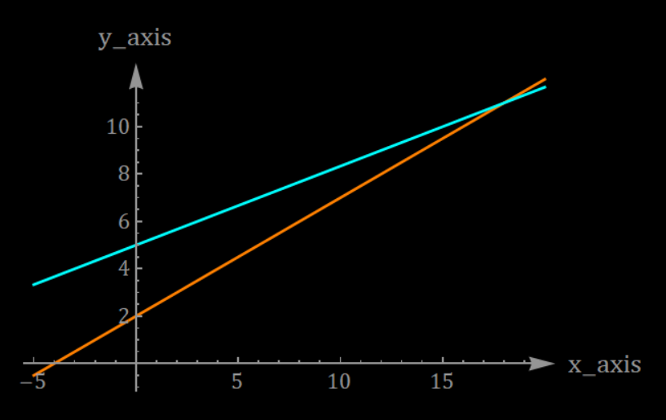
y_axis
x_axis

Slide 4
#F60000
#DF9702
#E2DE07
#2BD022
#0ECCF2
#4971F4
#A34AF1
#FF37EC

Slide 5
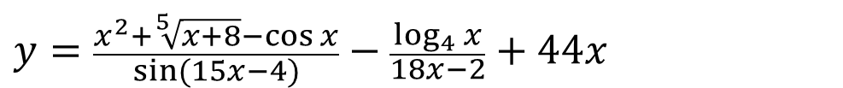





$$y=c$$
$$y=x^{n}$$
$$y=a^{x}$$
$$y=\log_{a}{x}$$
$$y=\sin{x}, \cos{x},\operatorname{tg}{x},\operatorname{ctg}{x}$$
$$y=\arcsin{x,\arccos{x,\operatorname{arctg}{x,\operatorname{arcctg}{x}}}}$$
$$y=\frac{x^{2}+\sqrt[5]{x+8}−\cos{x}}{\sin{(15x−4)}}−\frac{\log_{4}{x}}{18x−2}+44x$$

